Slide 1
CodeFurry 2022
Order Processing System

Slide 2

Project By :
Aditya Koul
Ananya Jaiswal
Anjali Parihar
Manish Jangid
Nameera Shaikh
Shivam Shakya
Yashaswi Ghune

Slide 3

Features of the Project
Order Processing System, Development in java jsp.
In This project you can place order.
Generate Invoice
Admin can change menu add,delete,remove menus.
Customer can put order.
Employee can track customer details.

Slide 4

Tools and Technologies Used
Tools :
Spring Tool Suite (STS)
Technologies :
Java
Java Servlet JSP
HTML
CSS

Slide 5

Key Learnings :
Concept clearance of Java and jsp
Hands On application building
Team Work
Team building
Co-operation
Task Management

Slide 6
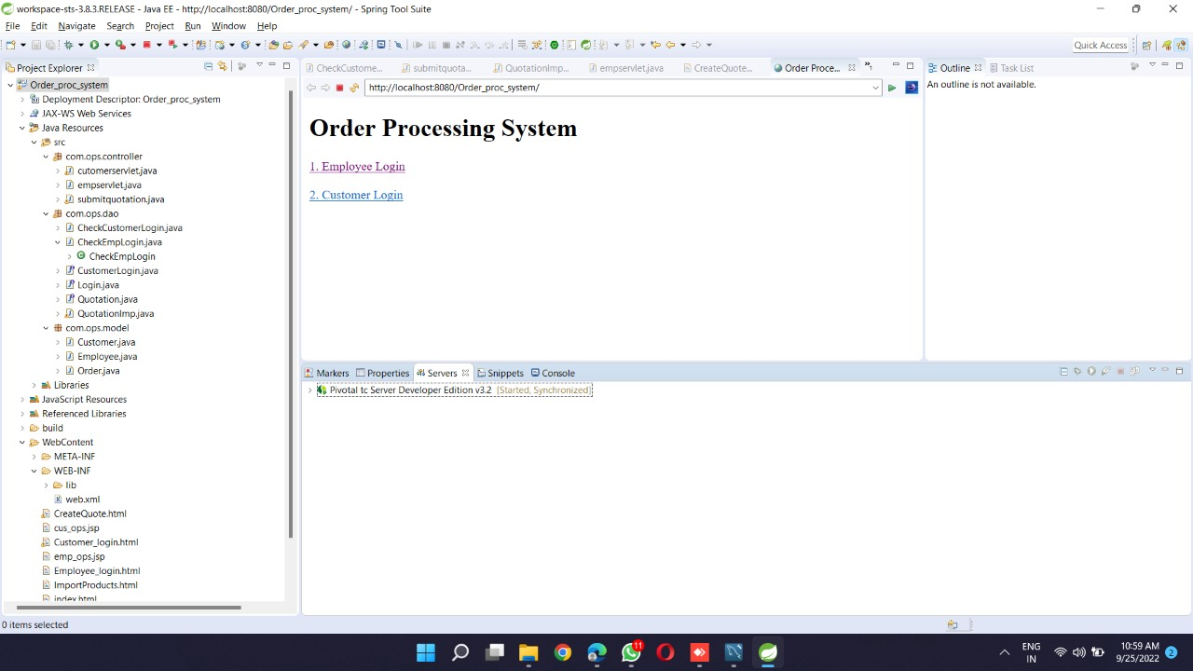
Project Snapshots

Slide 7
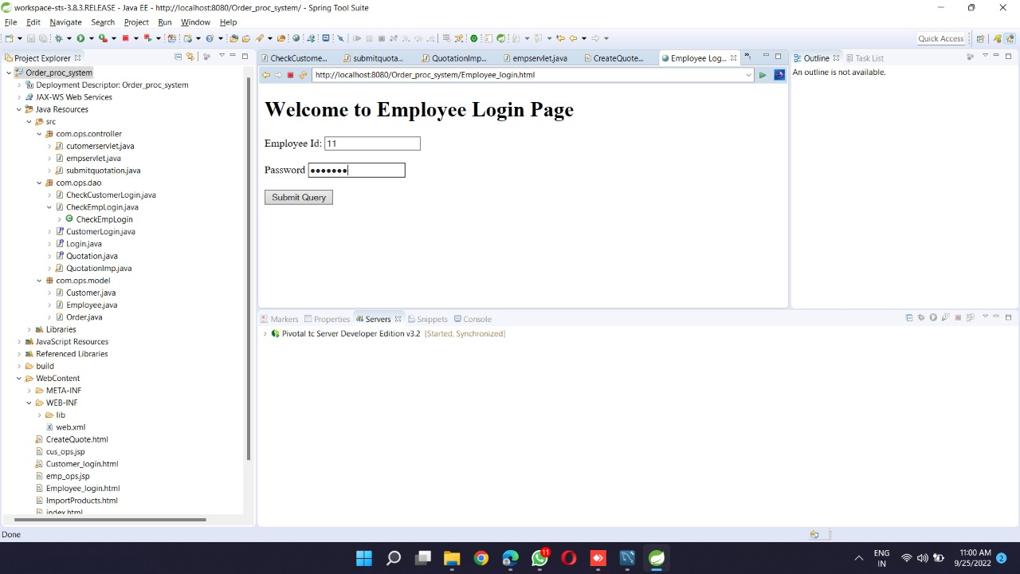
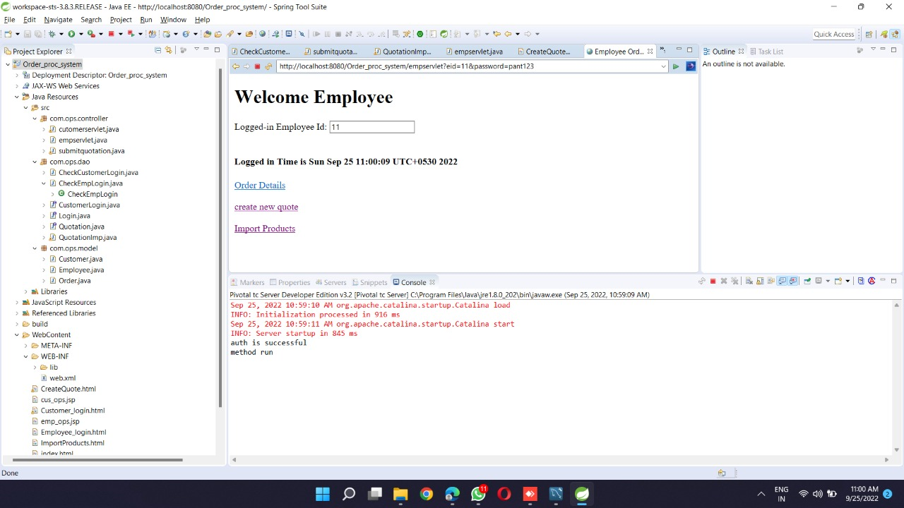
Employee Cycle

Slide 8
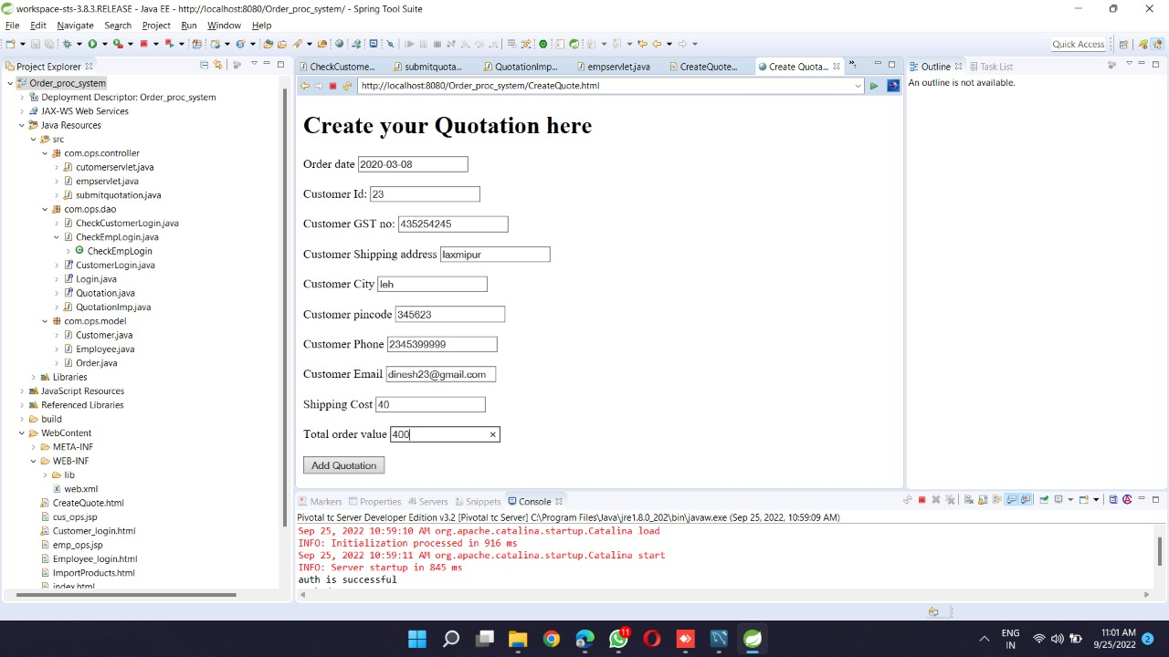

Slide 9
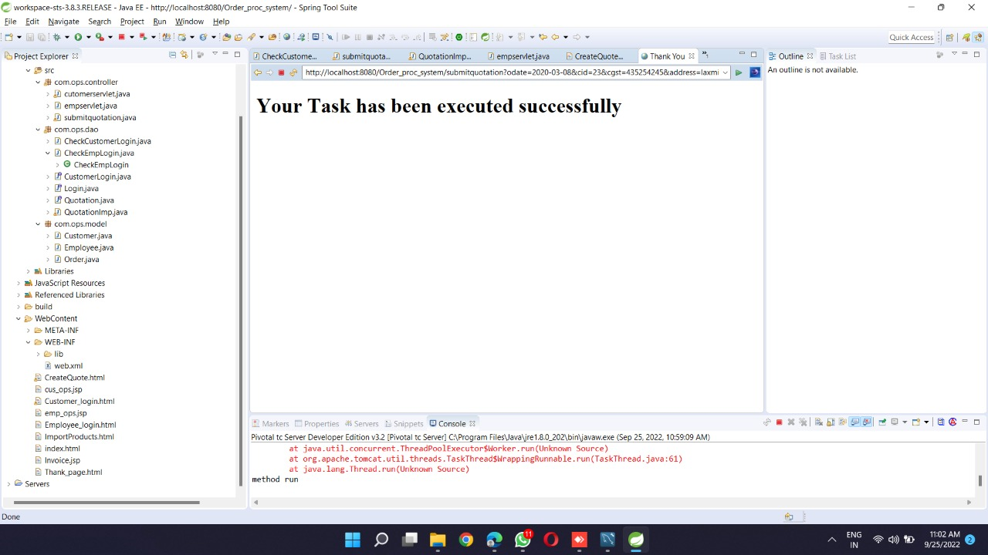

Slide 10
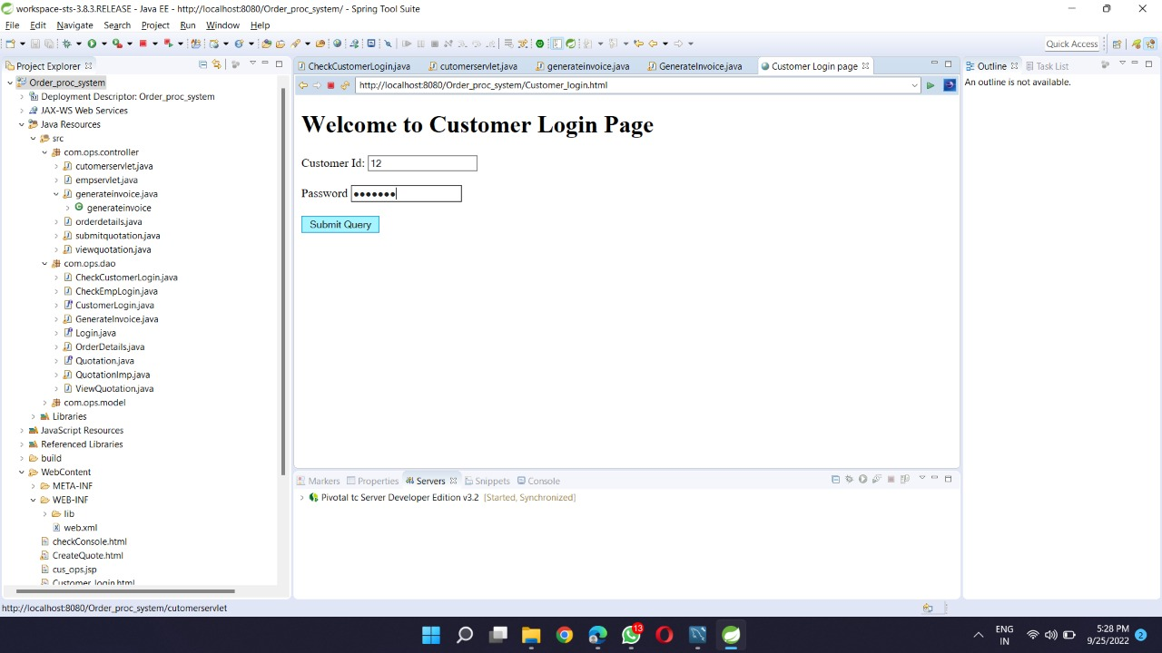
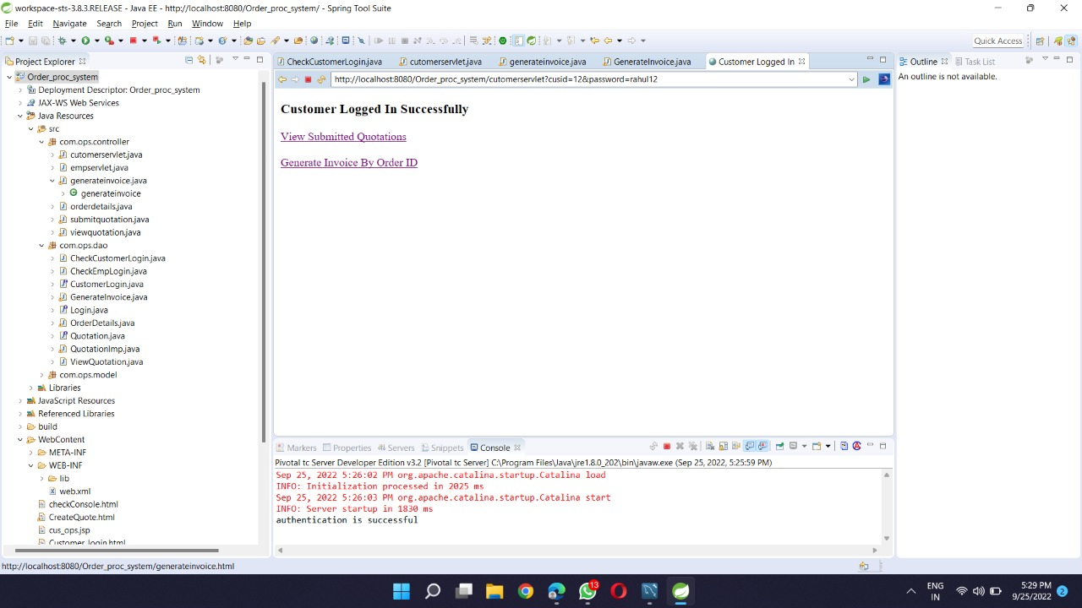
Customer login

Slide 11
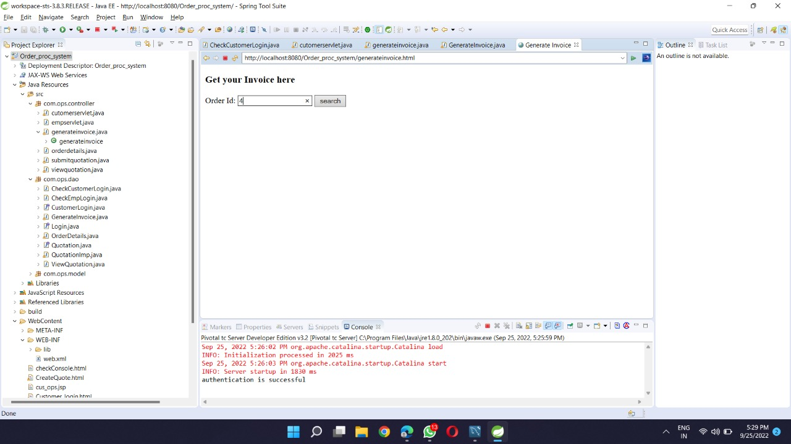
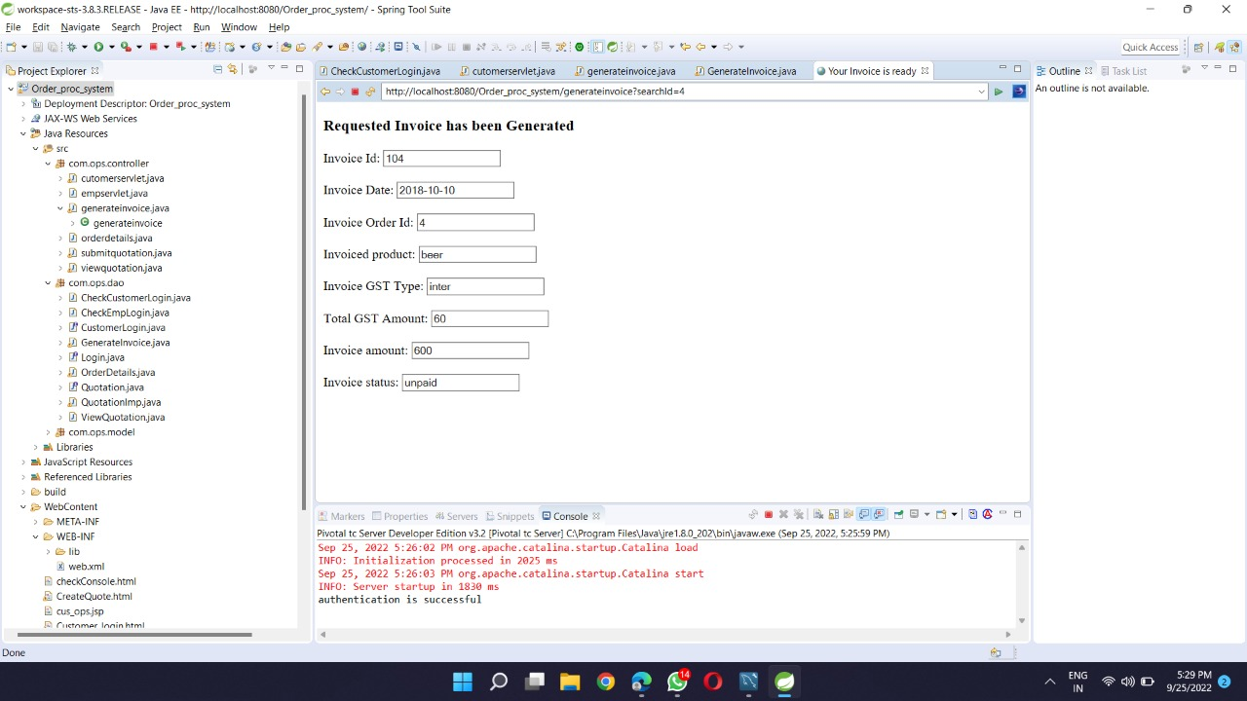
Invoice Generation

Slide 12
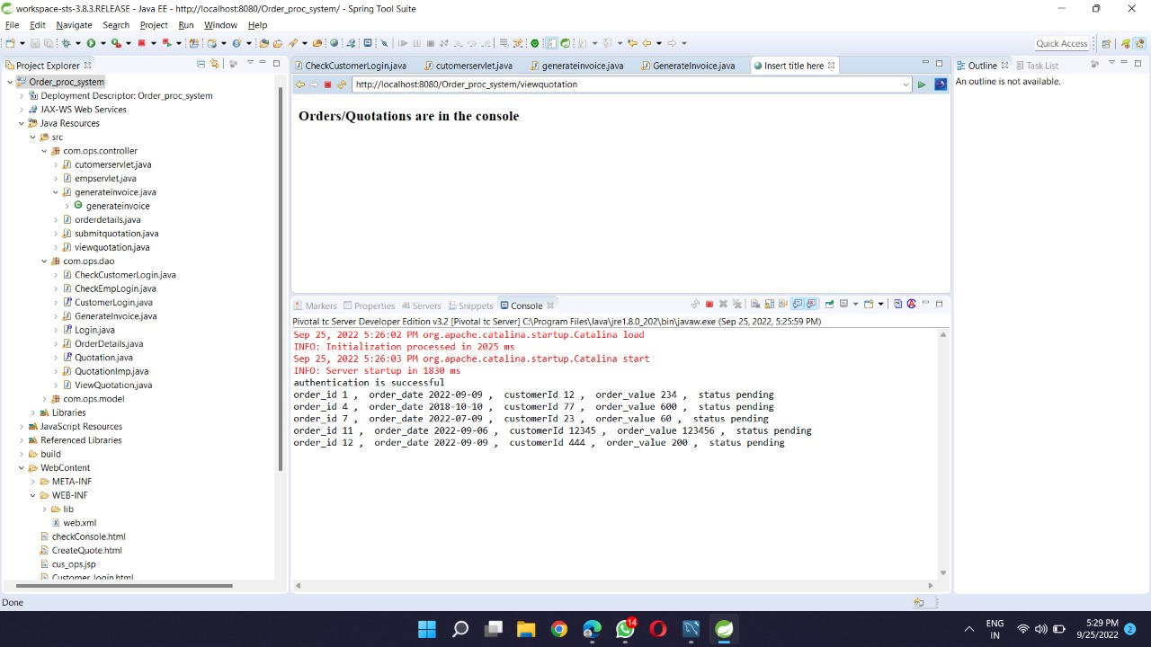

Slide 13
Future Work
Customize Orders
Enhance user interface by adding more responsive features
Add more payment options and save payment details
Add delivery options
Provide customer a visual graphical order status bar

Slide 14


